Slide 1

EPA Vehicle Fuel Economy
Ryan Garcia

Slide 2
Introduction
This project explores how vehicle types, manufacturers, and technical specifications drive fuel economy and annual fuel costs.
Data set contains over 38,000 records of vehicles with manufactured years ranging from 1984 to 2017.
Combined fuel economy is expressed as combined miles per gallon (combined MPG)
Average measure of how many miles a vehicle travels on one gallon of its primary fuel type (FT1) assuming 55% is city driving and 45% is highway driving
Annual fuel cost is based on 15,000 miles, 55% city driving and 45% highway driving, and the price of primary fuel used by a vehicle
Link to dataset: https://tf-assets-prod.s3.amazonaws.com/tf-curric/data-analytics-bootcamp/epa-fuel-economy.csv

Slide 3
Hypotheses
Ford and Chevrolet vehicles will have no significant difference in terms of fuel economy and annual fuel cost.
Compact vehicles will have significantly better fuel economy than midsize vehicles; expect compact vehicles to have significantly lesser annual fuel cost than midsize vehicles.
Subcompact vehicles will have significantly better fuel economy than compact vehicles; expect subcompact vehicles to have significantly lesser annual fuel cost than compact vehicles.
Subcompact vehicles will have significantly better fuel economy than midsize vehicles; expect subcompact vehicles to have significantly lesser annual fuel cost than midsize vehicles.

Slide 4
Hypotheses Cont.
Smaller vehicles will emit significantly less tailpipe CO2 than larger vehicles; subcompact vehicles will emit less tailpipe CO2 than compact vehicles and compact vehicles will emit less tailpipe CO2 than midsize vehicles.
Vehicles with Start/Stop technology will have significantly better fuel economy than vehicles without Start/Stop technology; vehicles with Start/Stop technology will have significantly lesser annual fuel cost than vehicles without Start/Stop technology.
Vehicles with manual transmissions will have significantly better fuel economy than vehicles with automatic transmissions; vehicles with manual transmissions will have significantly lesser annual fuel cost than vehicles with automatic transmissions.
Electric Vehicles (EV's) will have significantly better fuel economy than non-EV's; EV's will have significantly lesser annual fuel cost than non-EV's.

Slide 5
Data
The data set was collected by the United States Environmental Protection Agency (EPA).
Contains over 38,000 records with 3,719 unique vehicle models manufactured between 1984 and 2017.
Descriptive statistics for combined MPG and annual fuel cost appear to be normally distributed.
Notes:
Descriptive stats show evidence of some outliers on the high side of both categories, but no evidence of nulls on the low end.

Slide 6
Methods
Confirmed normal distribution for combined MPG and annual fuel cost
Performed Analysis ToolPak t-Test: Two Variables Assuming Unequal Variances
Randomized data into two groups and proved it is unbiased
Tested hypotheses by splitting data in two groups
P-values from the t-Tests were the determining factor for significant difference (or not)
Created Excel charts as visualizations for data comparison
Notes:
In statistics, the p-value is the probability of obtaining results at least as extreme as the observed results of a statistical hypothesis test, assuming that the null hypothesis is correct. ... A smaller p-value means that there is stronger evidence in favor of the alternative hypothesis.

Slide 7
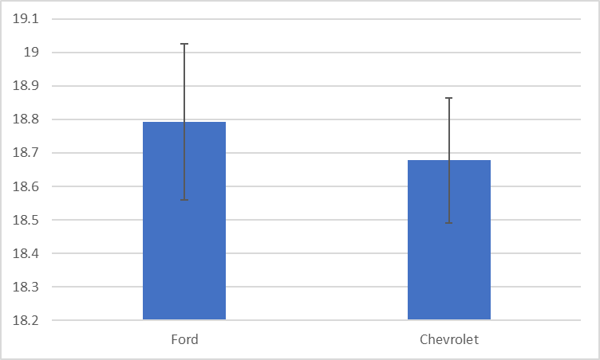
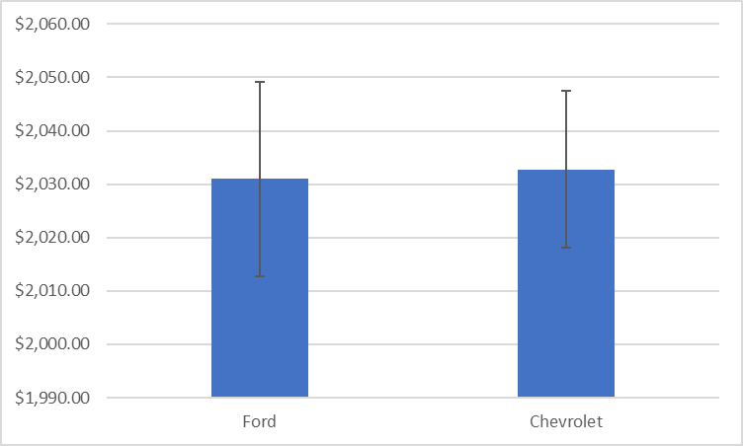
Ford vs. Chevrolet
There is not a significant difference between the two manufacturers.
With 95% confidence, Ford vehicles achieve a range of 0.183 less to 0.415 more combined MPG than Chevrolet vehicles.
With 95% confidence, the annual fuel cost for Ford vehicles is $25.14 less to $21.42 more than Chevrolet vehicles.
Notes:
2 largest vehicle manufacturers of this data set, 6965 sample size; p=0.4472, p=0.8834 respectively.

Slide 8
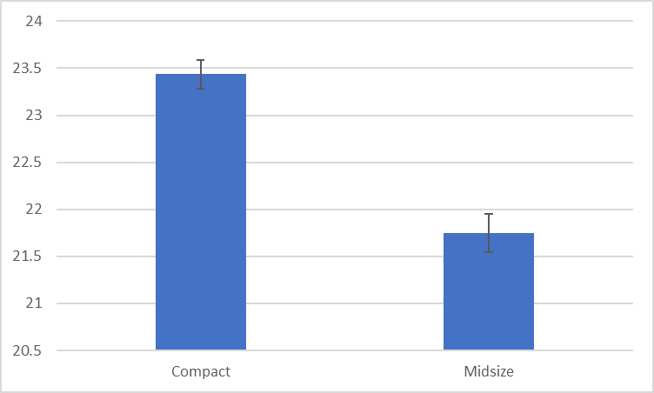
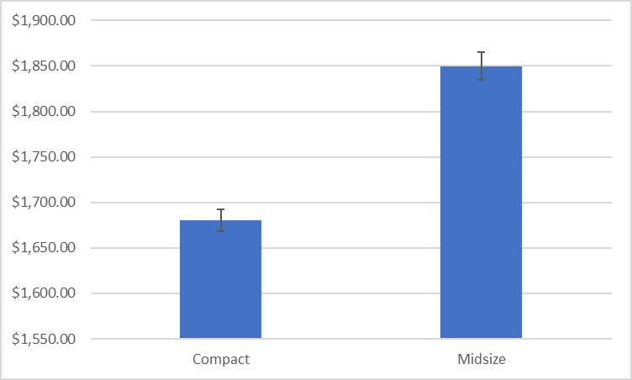
Compact vs. Midsize
There is a significant difference between the two vehicle classes.
With 95% confidence, compact vehicles achieve 1.433 - 1.944 more combined MPG than midsize vehicles.
With 95% confidence, the annual fuel cost of compact vehicles is $149.82 - $188.66 less than midsize vehicles.
Notes:
Sample size 9903; p=5.0584e-38, p=2.2802e-64 respectively.

Slide 9
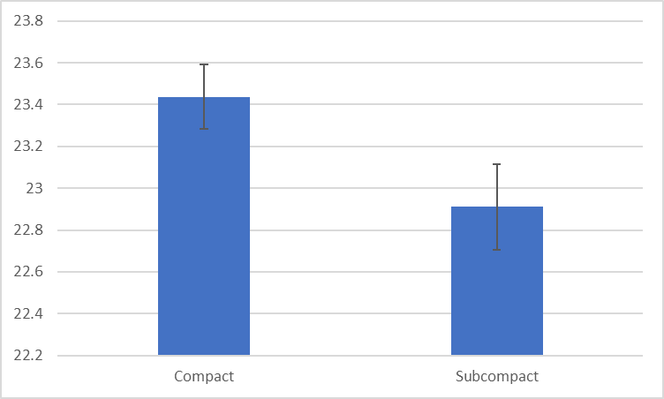
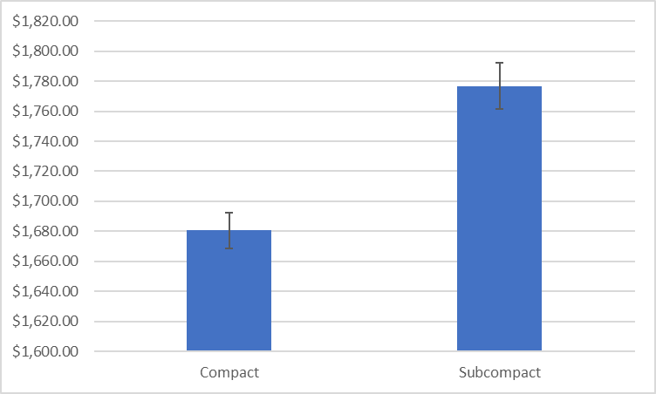
Compact vs. Subcompact
There is a significant difference between the two vehicle classes.
With 95% confidence, compact vehicles achieve 0.270 - 0.784 more combined MPG than subcompact vehicles.
With 95% confidence, the annual fuel cost of compact vehicles is $77.13 - $115.54 less than subcompact vehicles.
Appears that compact outperforms subcompacts due to technological advancements – from 1999 to 2017, production of compact vehicles outnumbers subcompact 3,074 to 1,920.
Notes:
Sample size 10380; p=5.9816e-5, p=1.045e-22 respectively.
From 1999 - 2017, there are 3,074 compact vehicle records (56% of total compact vehicles) versus 1,920 subcompact vehicle records (39% of total subcompact vehicles).

Slide 10
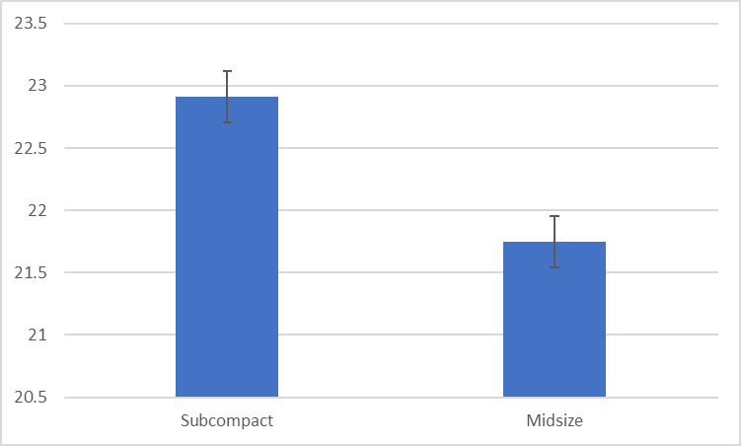
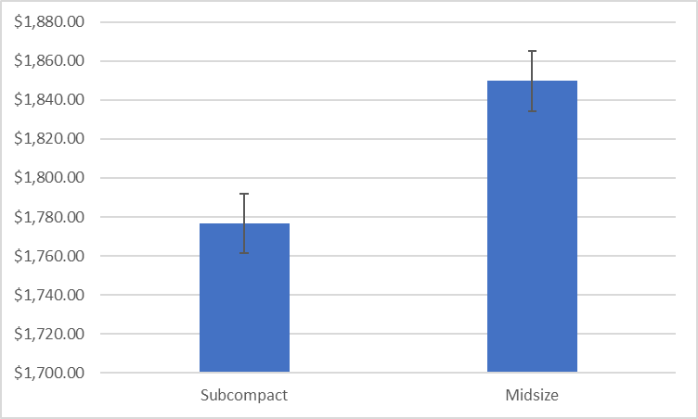
Subcompact vs. Midsize
There is a significant difference between the two vehicle classes.
With 95% confidence, compact vehicles achieve 0.871 - 1.452 combined MPG greater than subcompact vehicles.
With 95% confidence, the annual fuel cost of subcompact vehicles is between $94.58 less and $32.74 more than midsize vehicles.
Notes:
Sample size 9267; p=5.450E-15, p=4.586E-11 respectively.

Slide 11
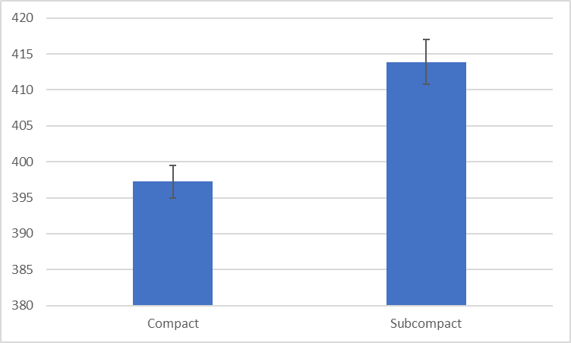

Tailpipe CO2
There is a significant difference between compact, subcompact, and midsize vehicles.
The tailpipe CO2 emissions have a negative correlation with combined MPG for these vehicle classes.
With 95% confidence, compact vehicles emit 12.836 - 20.499 g/mi less tailpipe CO2 than subcompact vehicles.
With 95% confidence, subcompact vehicles emit 16.393 - 25.148 g/mi less tailpipe CO2 than midsize vehicles.
Notes:
Sample size 9267; p=5.450E-15, p=4.586E-11 respectively.

Slide 12
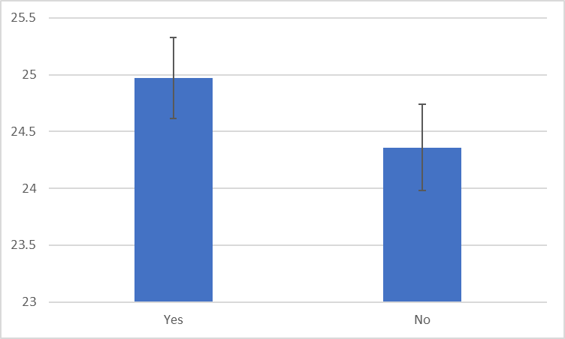
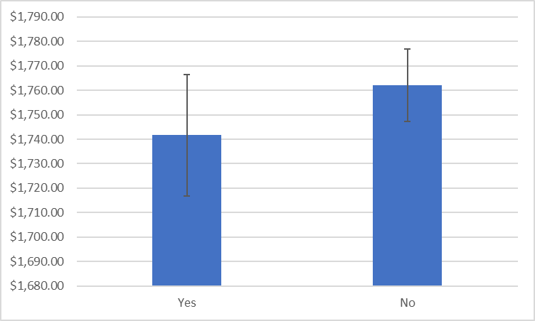
Start/Stop Technology
There is a significant difference in combined MPG.
There is not a significant difference in annual fuel cost.
With 95% confidence, vehicles with start/stop technology achieve 0.090 - 1.136 combined MPG more than vehicles without this technology.
With 95% confidence, the annual fuel cost for vehicles with start/stop technology is between $49.36 less and $8.39 more than vehicles without this technology.
Notes:
Sample size 6443; p=0.0217, p=0.1642

Slide 13
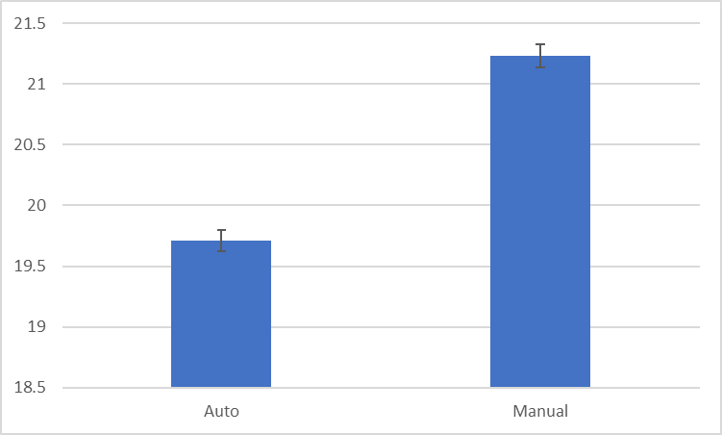
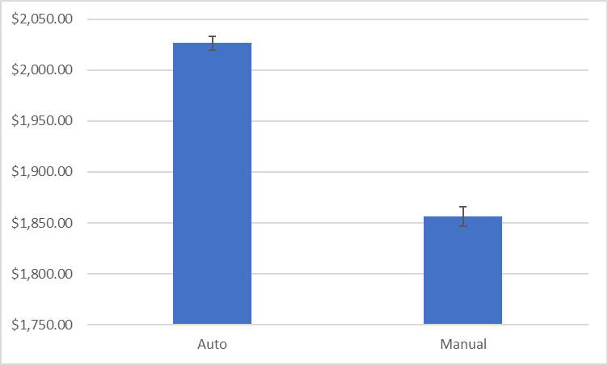
Automatic vs. Manual Transmission
There is a significant difference between automatic and manual transmission vehicles.
With 95% confidence, vehicles with manual transmissions achieve 1.392 - 1.692 combined MPG more than vehicles with automatic transmissions.
With 95% confidence, the annual fuel cost for vehicles with manual transmissions is $158.76 - $181.32 less than vehicles with automatic transmissions.
Notes:
Sample size 38102; p=5.9513e-116, p=1.18966171108874E-188

Slide 14
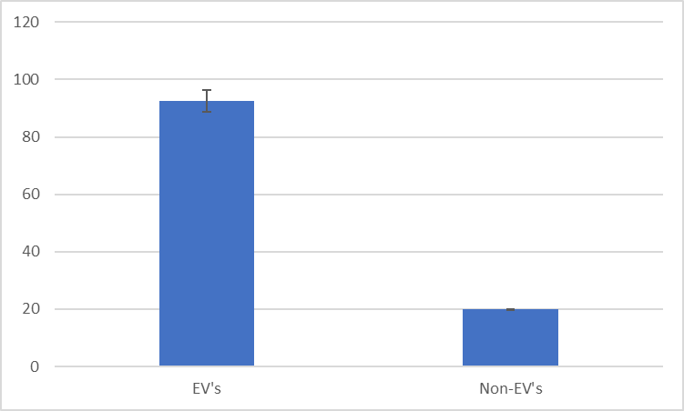
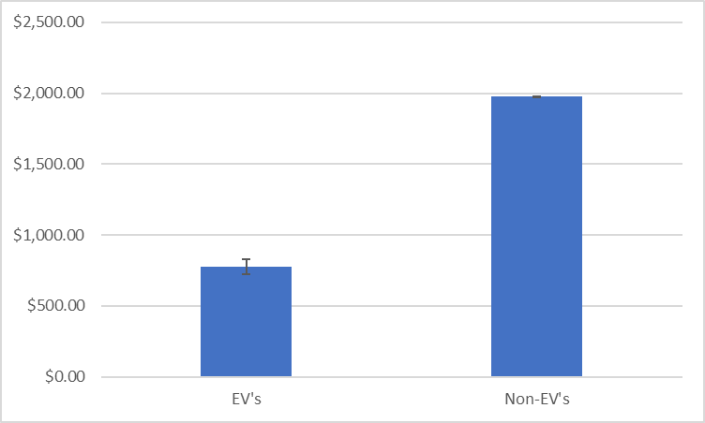
Electric Vehicles vs. Non-Electric Vehicles
There is a significant difference between EV’s and non-EV’s.
With 95% confidence, EV's achieve 68.814 - 76.450 combined MPG more than non-EV’s.
With 95% confidence, the annual fuel cost of EV's is $1,146.92 to $1,251.68 less than non-EV’s.
Notes:
Sample size 38113; p=1.947E-72, p=1.668e-83.

Slide 15
Recommendations
Drive Ford or Chevrolet
Drive vehicles of classes in this priority: compact, subcompact, and midsize
Drive vehicles with start/stop technology
Drive manual transmission vehicles opposed to automatic vehicles
EV’s significantly outperform non-EV's in combined MPG and annual fuel cost
Consider as an option, but get more data on EV’s as there are approximately 130 records
Notes:
Drive vehicles in this order to achieve improved combined MPG, lower annual fuel economy, and lower tailpipe CO2 emissions: compact, subcompact, and midsize.
Drive vehicles with start/stop technology; combined MPG is significantly better and even though there is no significant difference in the annual fuel cost, the 95% confidence interval weighs heavily in the range that less annual fuel cost is attained

